Slide 1
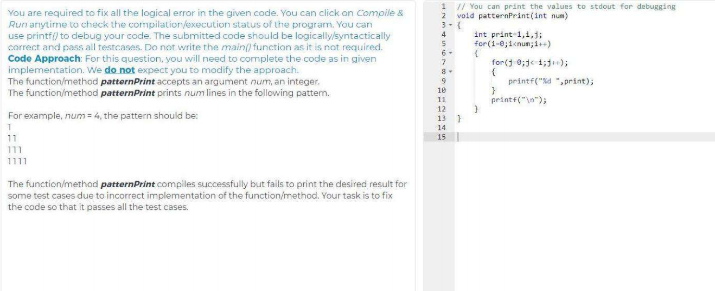

Slide 2
Solution:
Remove the semicolon at the end of second for loop (inner loop j)

Slide 3
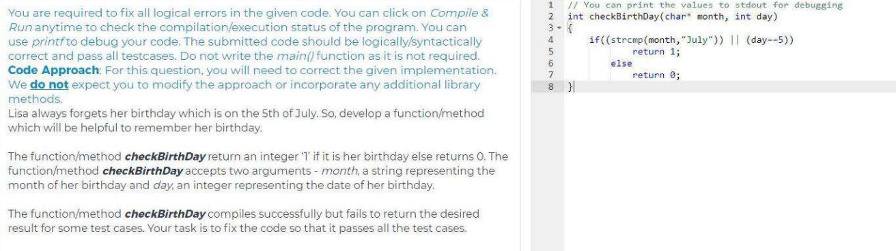

Slide 4
Solution
int checkBirthday(char* month, int day)
{
if( !(strcmp(month,"July")) && (day==5) )
return 1;
else
return 0;
}

Slide 5
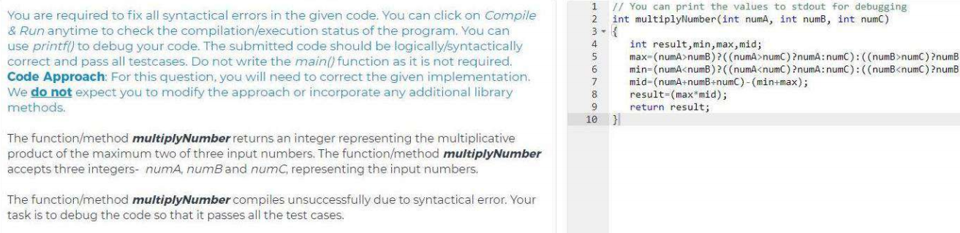

Slide 6
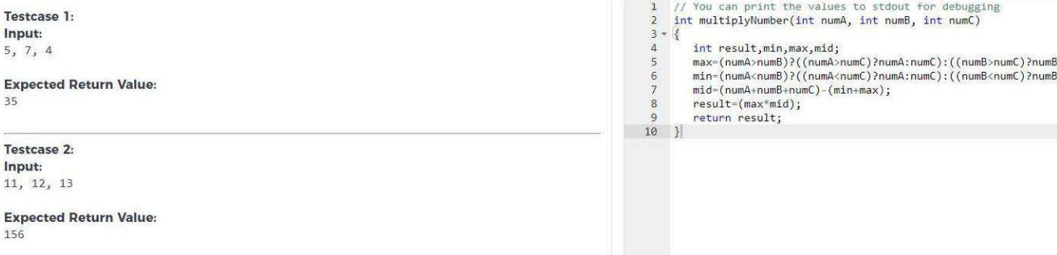

Slide 7
max = (a>b) ? ((a>c) ? a: c) : ((b>c) ? b: c);
min = (a<b) ? ((a<c) ? a : c) : ((b<c) ? b: c);
mid = (a + b + c) - (max + min);
result = max*mid ;
return result;

Slide 8
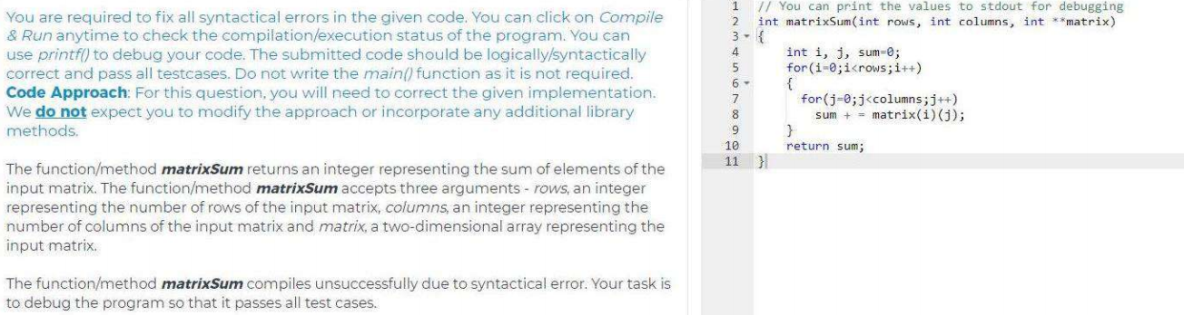

Slide 9
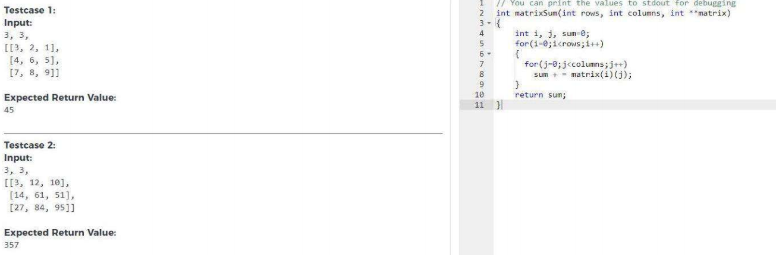

Slide 10
Solution
Int matrixSum ( int rows, int columns, int **matrix)
{
Int I, j, sum = 0;
for(i=0 ; i<rows ; i++)
{
for(j=0 ; j<columns ; j++)
sum = sum + matrix[i][j];
}
return sum;
}

Slide 11
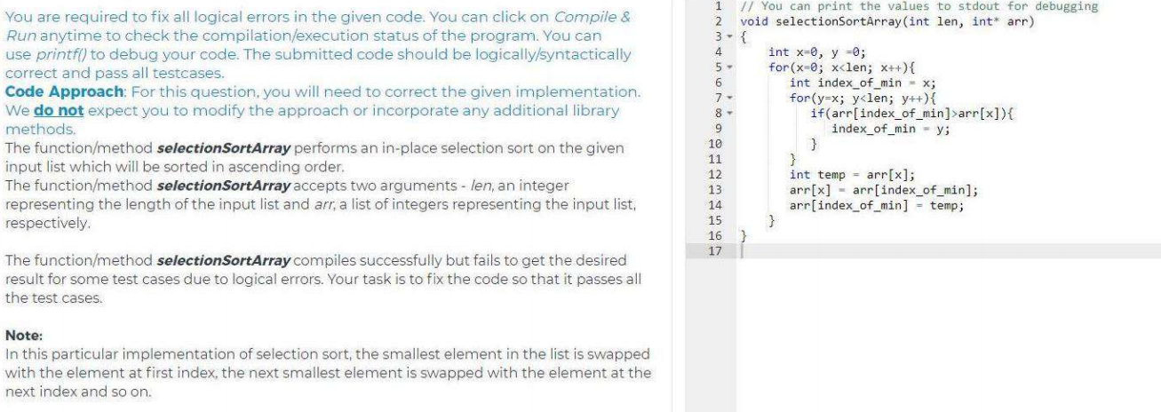

Slide 12
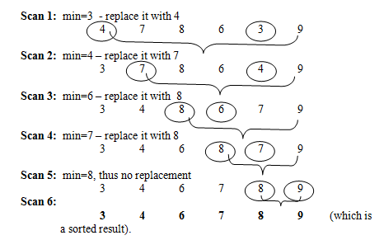

Slide 13
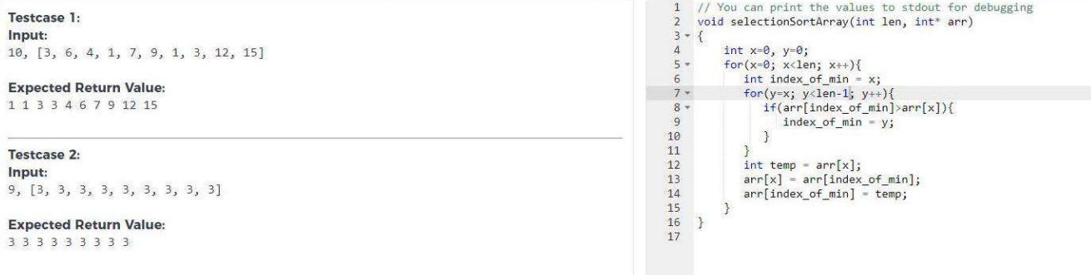

Slide 14
Soultion:
Outer for loop x < len-1
Inner for loop y = x+1
At if (arr [index_of_min] > arr[ y])
Before swap place this condition if(index_of_min != i)

Slide 15
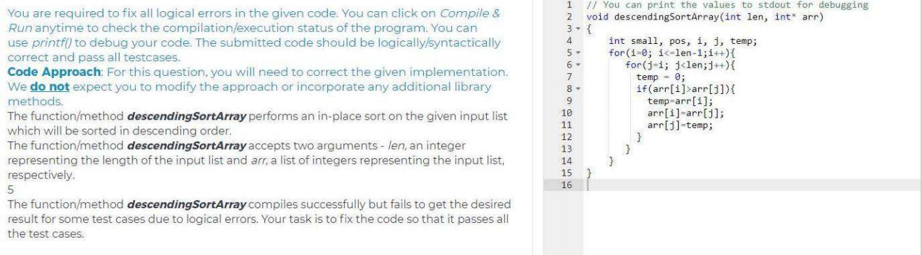

Slide 16
Solution
Outer for loop i < len-1
Inner for loop j = i +1
If condition arr[i] < arr[ j]

Slide 17
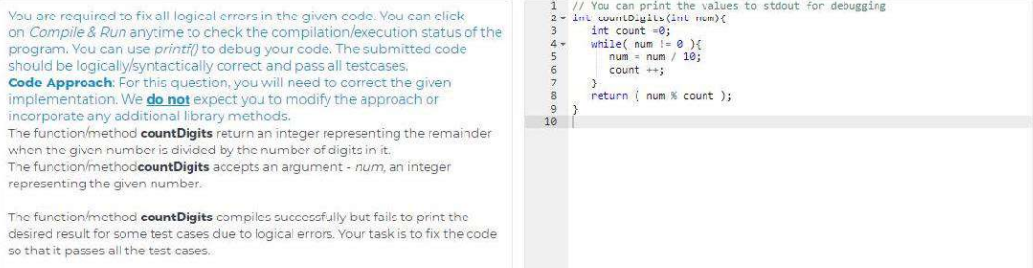

Slide 18
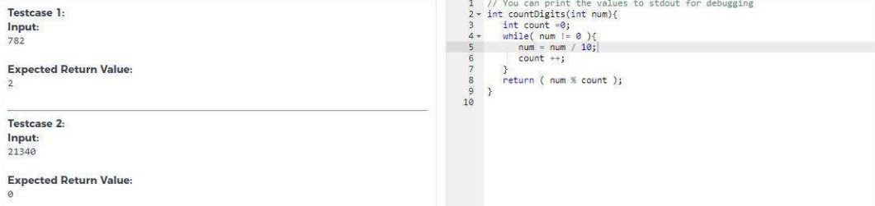

Slide 19
Solution
Store the num in one variable
int temp = num
after while loop performing
return temp % count

Slide 20
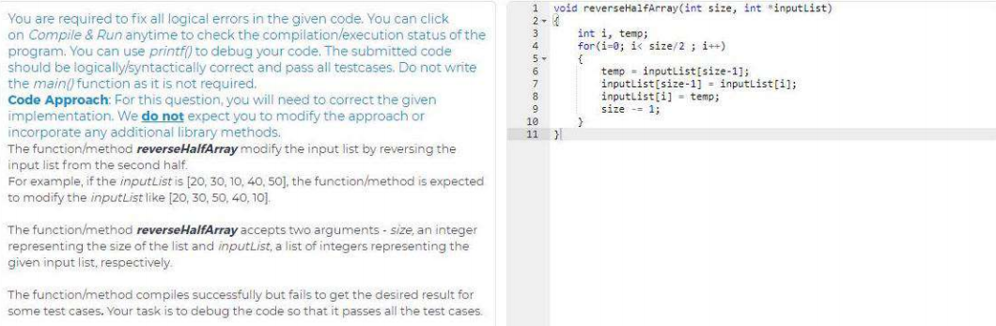

Slide 21
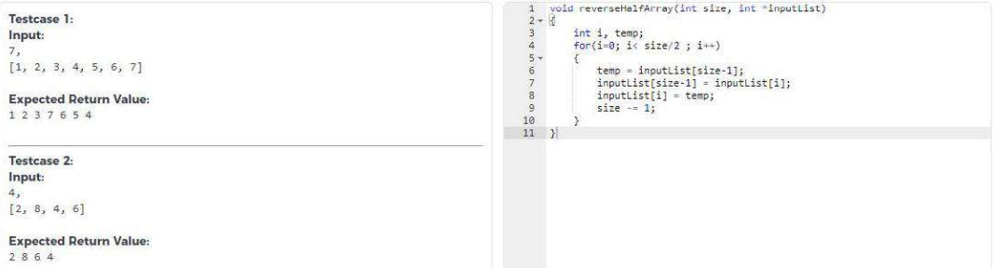

Slide 22
Solution
for(i=size/2; i<size; i++)
{
temp = inputlist[size-1];
inputlist[size-1] = inputlist[i];
inputlist[i] = temp;
size--;
}

Slide 23
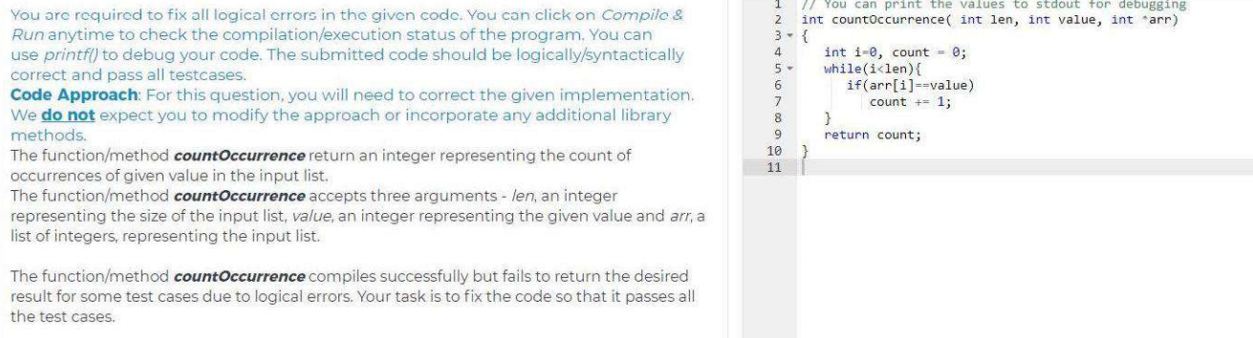

Slide 24
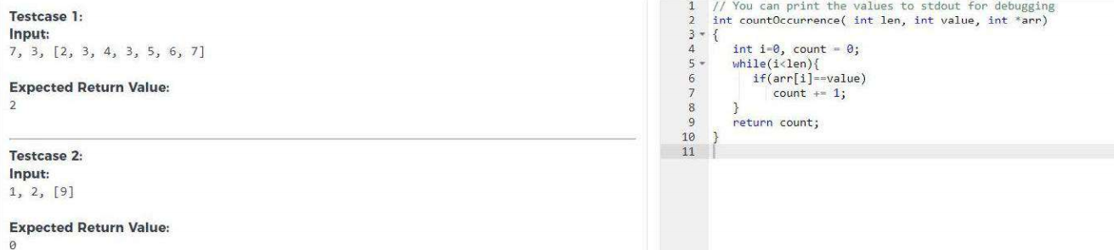

Slide 25
Solution:
After count value increasing
Place i = i+1 inside of while loop

Slide 26
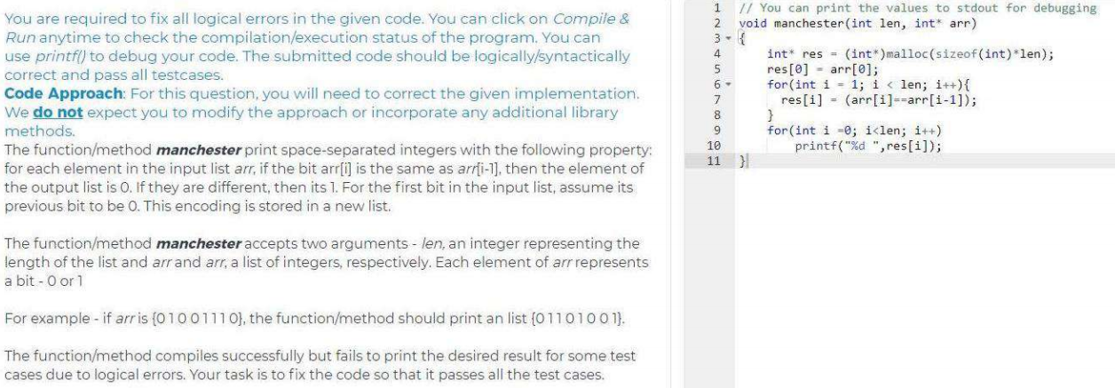

Slide 27
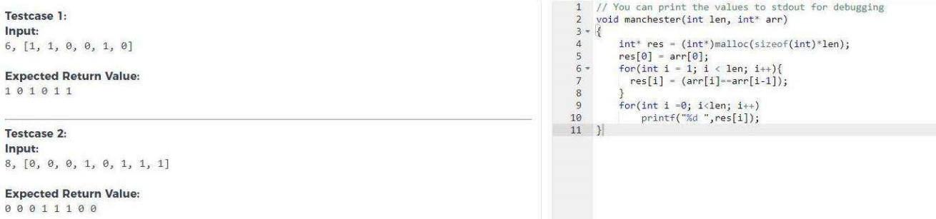

Slide 28
Modify:
res[i] = ! (arr[i] == arr[i-1])

Slide 29
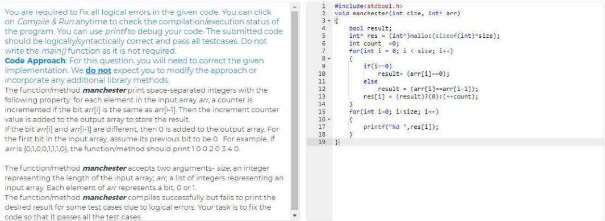

Slide 30
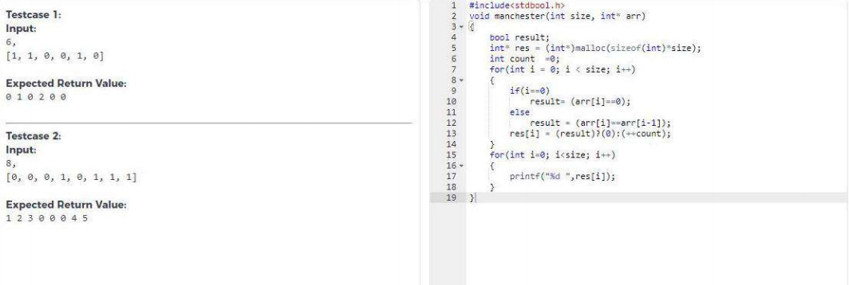

Slide 31
solution
With in the for loop last statement
If(i==0) {
result = (arr[i] == 0);
count++;
}
Else
result = (arr[i] == arr[i-1])
res[i] = (result) ? (Count++) : (0) ;
(or)
res[i] =! (result) ? (0) : (Count++) ;

Slide 32
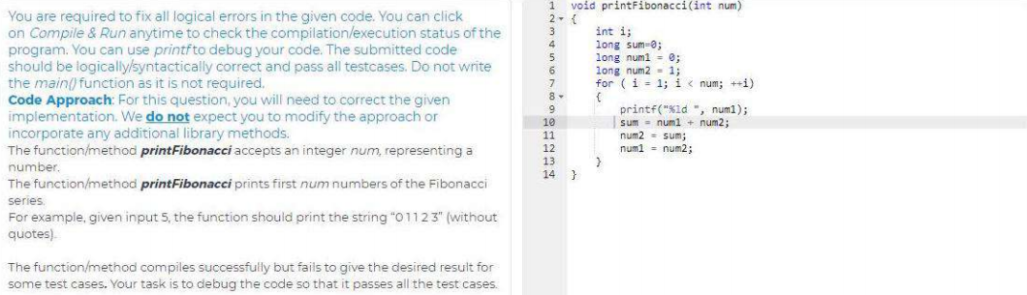

Slide 33
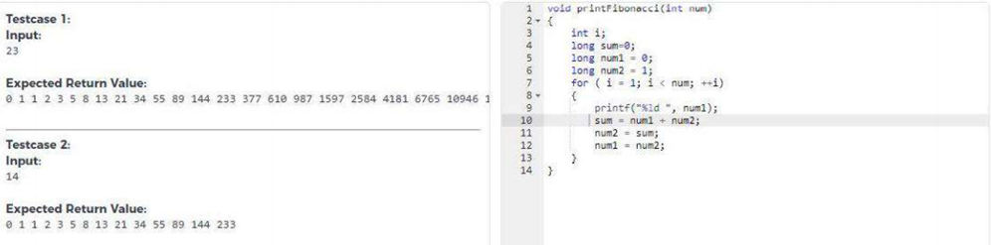

Slide 34
printf(" %d %d",num1,num2);
for(i=3; i<=num; ++i)
{
sum = num1 + num2;
printf(" %d",sum);
num1 = num2;
num2 = sum;
}

Slide 35
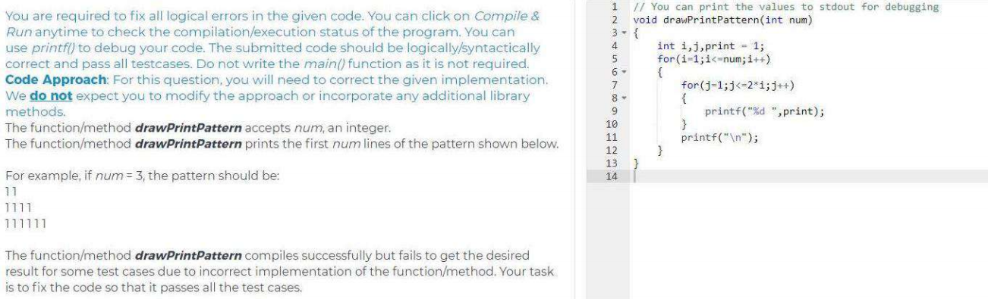

Slide 36
printf(“%d”,print); /* remove the space in control string */

Slide 37
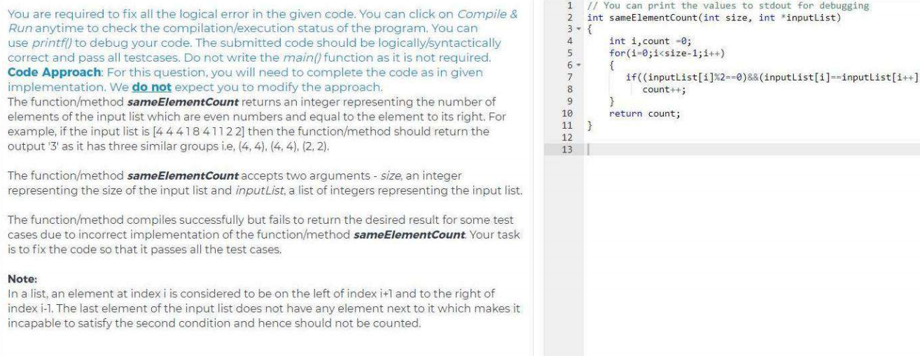
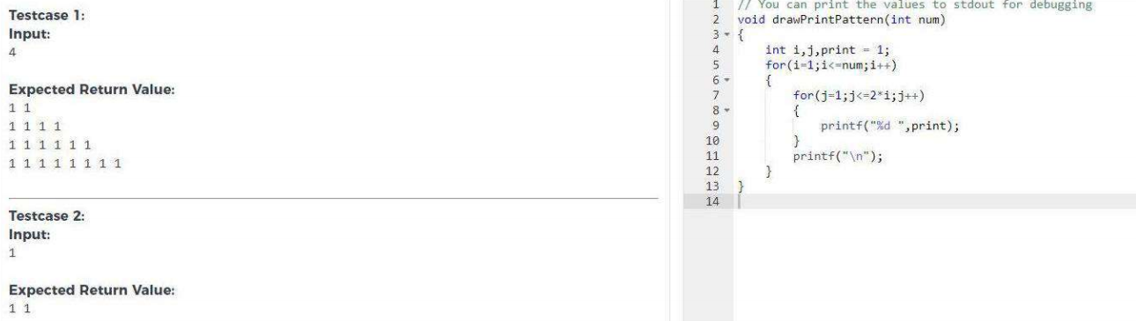

Slide 38
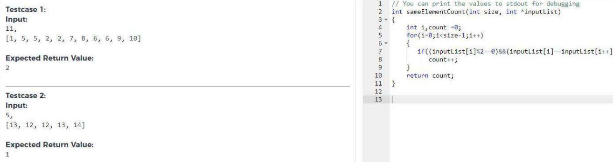

Slide 39
Solution
With in the for loop
If((inputlist[i]%2==0) && (inputlist[i] == inputlist[i+1]))

Slide 40
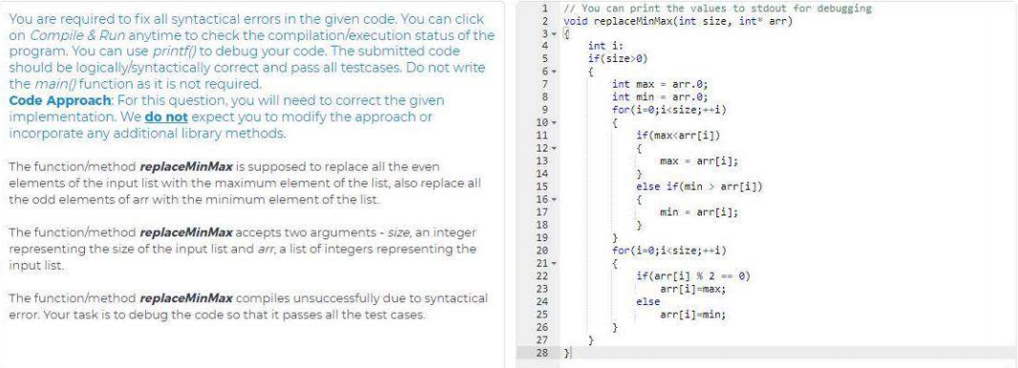

Slide 41
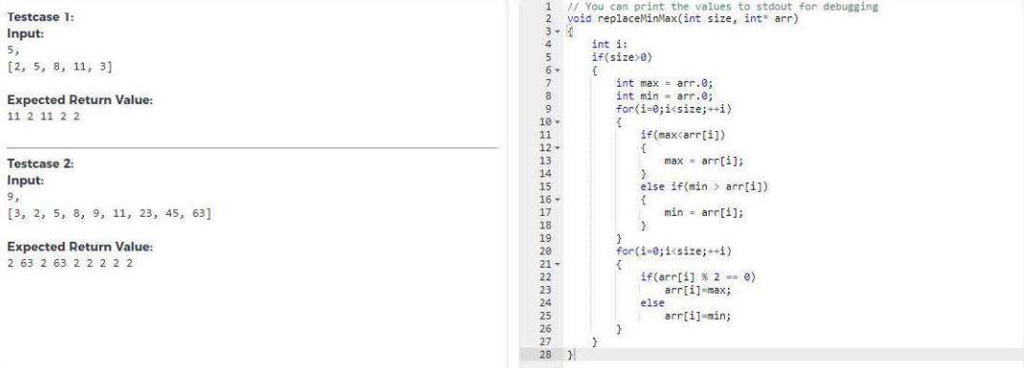

Slide 42
Solution
Int max = arr[0];
Int min = arr[0];

Slide 43
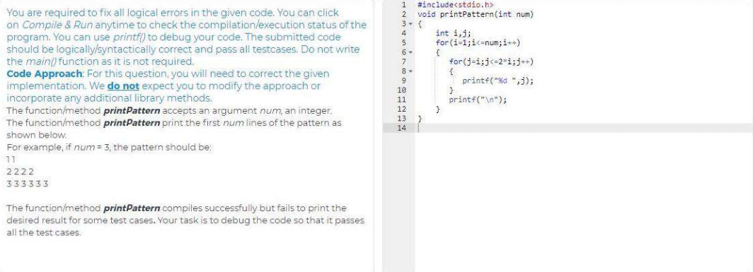

Slide 44
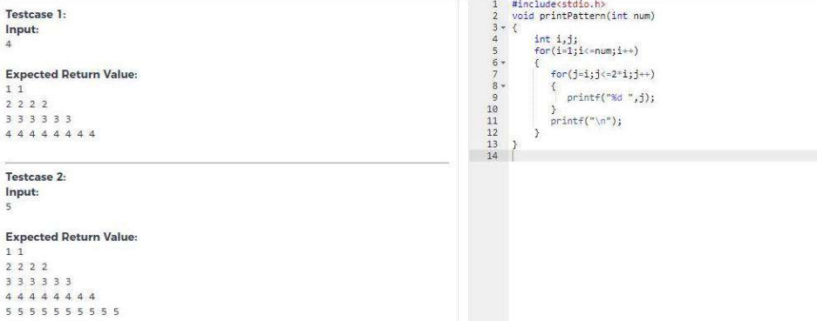

Slide 45
Solution
In inner for loop
for(j=1 ;j<=2*i; j++)
{
printf(“%d “,i);
}

Slide 46
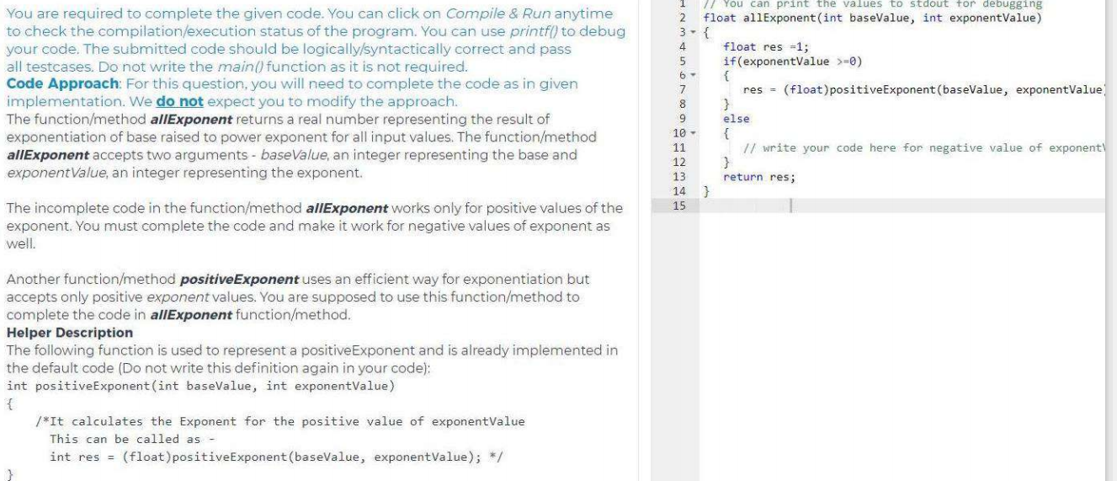

Slide 47
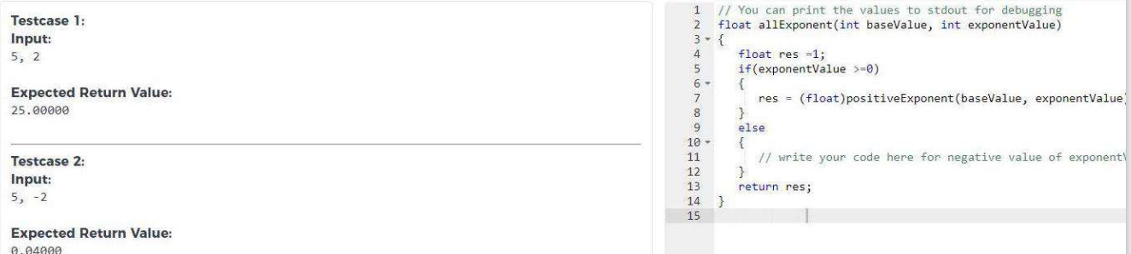

Slide 48
res = (float) negativeExponent(basevalue, exponentvalue);
int negativeExponent(int basevalue, int exponentvalue)
{
float n;
clrscr();
n=1.0/(pow(basevalue , exponentvalue));
return n;
}

Slide 49
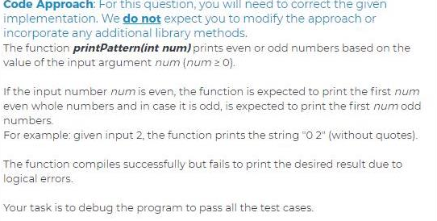

Slide 50
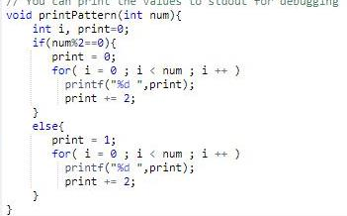

Slide 51
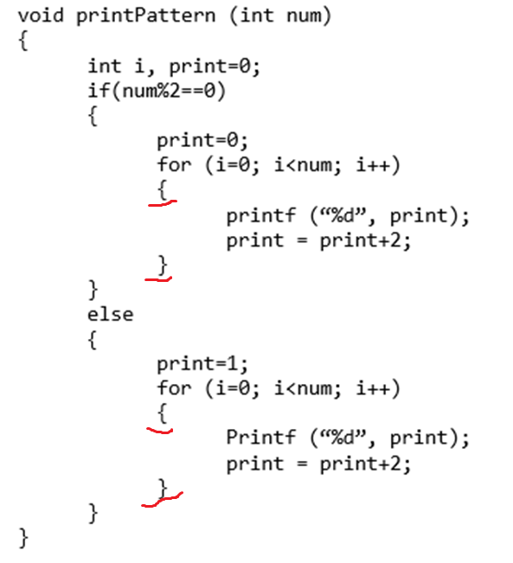

Slide 52
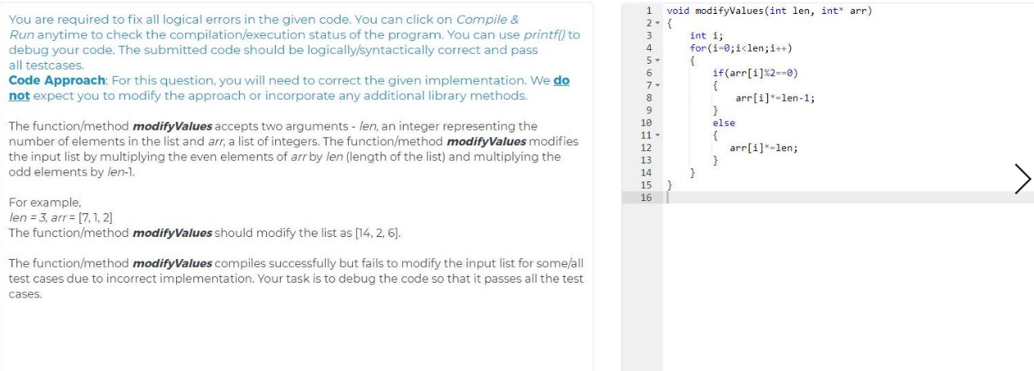

Slide 53
If(arr[i]%2 == 0)
{
arr[i] *= len;
}
else
{
arr[i] *= (len-1);
}

Slide 54
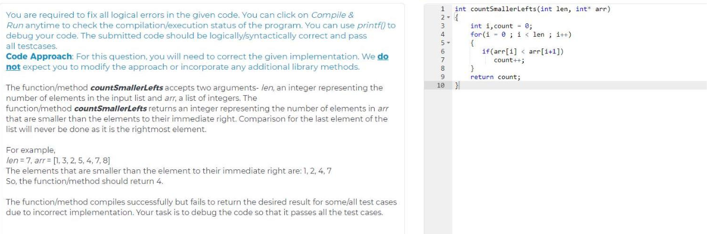

Slide 55
for(i=0;i<len-1;i++)

Slide 56
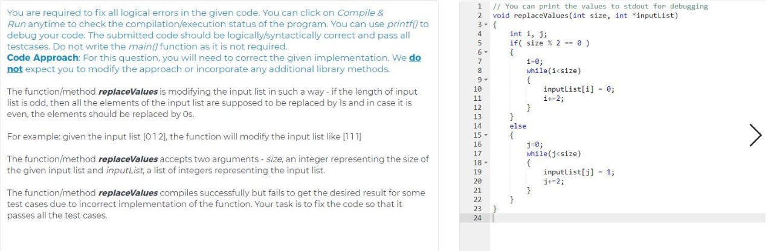

Slide 57
If(size%2 == 0)
{
In while loop
i = i+1;
}
else {
In while loop
j=j+1;
}

Slide 60
res = 1.0 / (float) negativeExponent(basevalue, exponentvalue);

Slide 61
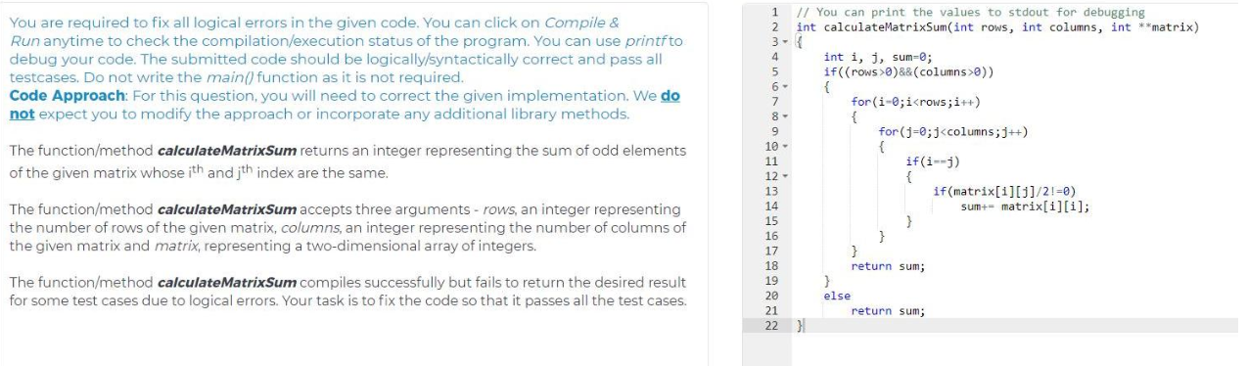

Slide 62
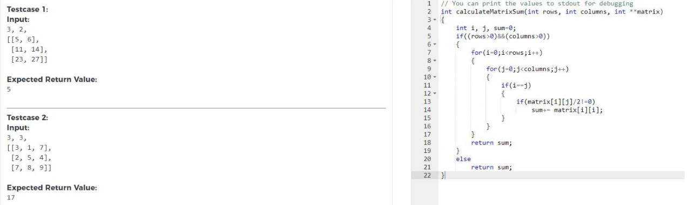

Slide 63
If(i==j)
{
If(matrix[i][j]%2 != 0)
Sum += matrix[i][ j];
}

Slide 64
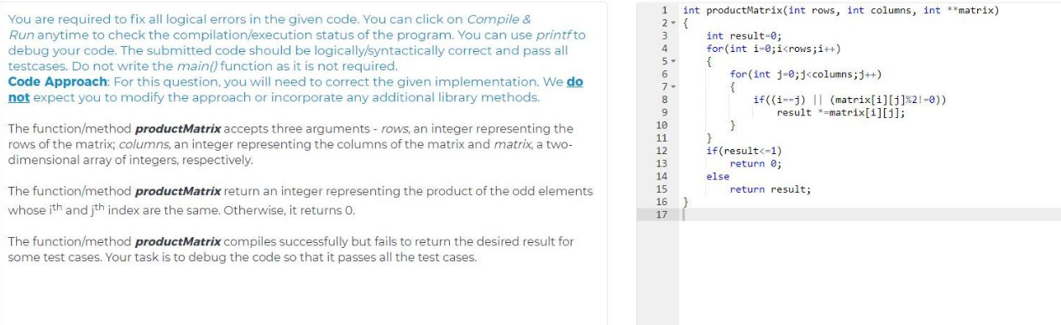

Slide 65
int result = 1;
With in the inner for loop
If((i == j) && (matrix[i][j] %2 != 0)

Slide 66
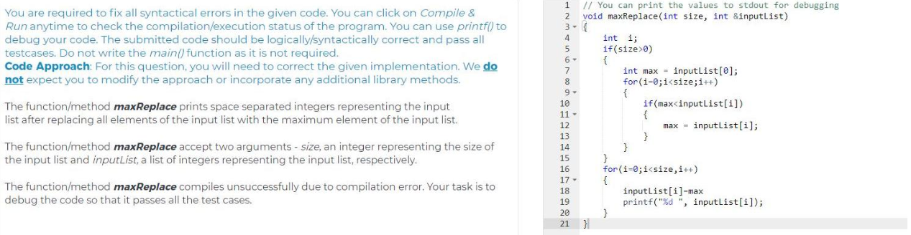

Slide 67
void maxReplace (int size, int *inputlist)
{
If(size > 0)
{
for(i=1; i<size; i++)
{
}
}
for(i=0; i<size; i++)
{
inputlist[i] = max;
Printf(“%d “,inputlist[i]);
}
}

Slide 68
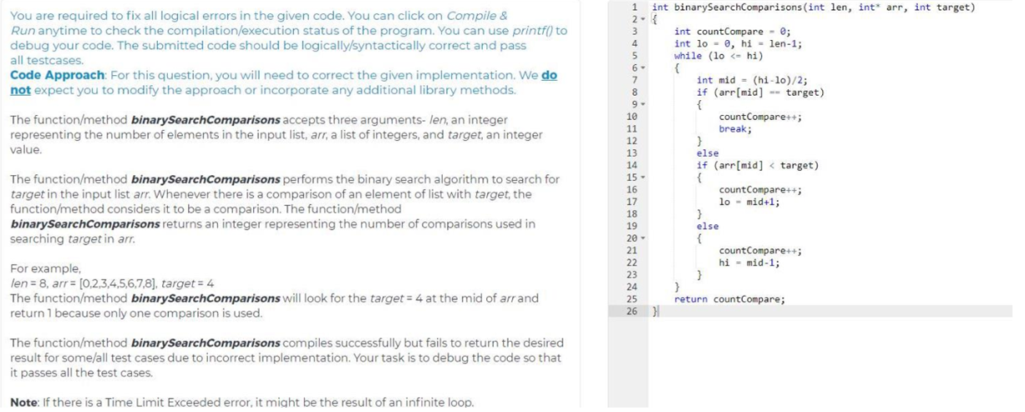

Slide 69
With in the while loop
mid = (lo + hi)/2;

Slide 70
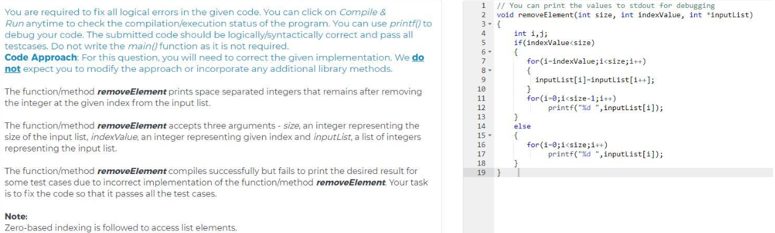

Slide 71
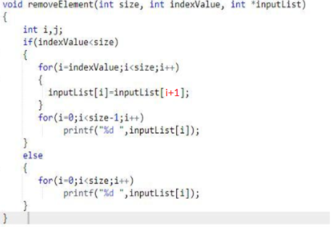

Slide 72
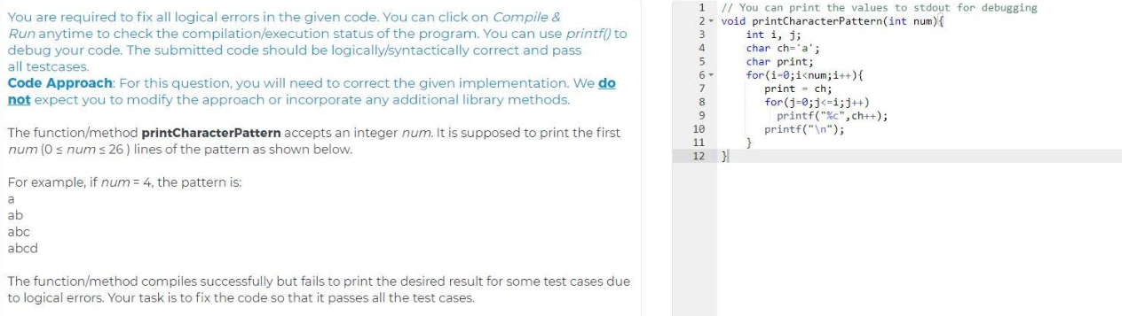

Slide 73
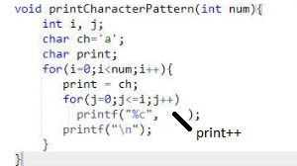

Slide 74
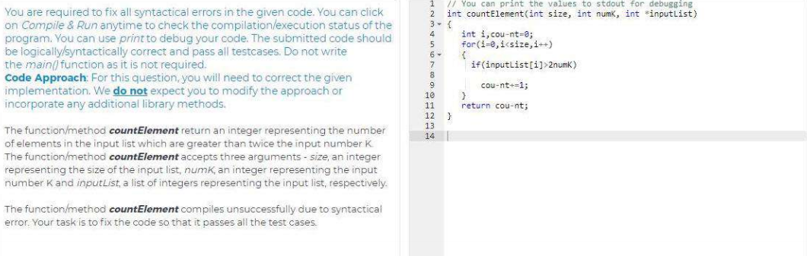

Slide 75
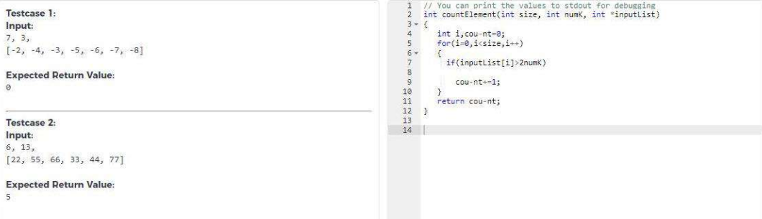

Slide 76
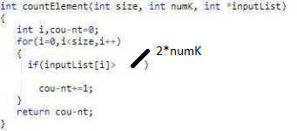

Slide 77


Slide 78
Answer:
Line no-26. printf(“%d “, inputList[i]);

Slide 79


Slide 80


Slide 81


Slide 82
Answer:
case 0 :
str = “Monday”;
break;
case 1 :
str = “Tuesday”;
break;
case 2 :
str = “Wenesday”;
break;
case 3 :
str = “Thursday”;
break;
case 4 :
str = “Friday”;
break;
case 5 :
str = “Saturday”;
break;
case 6 :
str = “Sunday”;
break;

Slide 83


Slide 84
int findmaxElement(int len1, int* arr1, int len2, int*arr2)
{
arr1 = sortArray(len1, arr1);
arr2 = srotArray(len2, arr2);
if(arr1[len1-1] > arr2[len2-1])
return arr1[len1-1];
else
return arr2[len2-1];
}

Slide 85


Slide 86


Slide 87
int difference_in_times(Time* time1, Time* time2)
{
int dif = Time_compareTo(time1,time2);
if(diff == 1)
{
return (time1.hour – time2.hour)*60*60+(time1.minute – time2.minute)*60+(time1.second – time2.second);
}
else if( diff == -1)
{
return (time2.hour – time1.hour)*60*60+(time2.minute – time1.minute)*60+(time2.second – time1.second);
}
else
{
return 0;
}
}

Slide 88


Slide 89


Slide 90


Slide 91
int isTraingle(Point *p1, Point *p2, Point *p3) {
int result = p1.x * (p2.y-p3.y)+p2.x * (p3.y – p1.y) + p3.x * (p1.y-p2.y);
result = result / 2 ;
if( result == 0)
return 0;
else
return 1;
}

Slide 92
int isTraingle(Point *p1, Point *p2, Point *p3)
{
double l1= Point_calculateDistance(p1,p2);
double l2= Point_calculateDistance(p2,p3);
double l3= Point_calculateDistance(p1,p3);
if(((l1+l2)>l3) && ((l2+l3)>l1) && ((l1+l3)>l2))
return 1;
else
return 0;
}

Slide 93


Slide 94
Median Formula
The formula to calculate the median of the data set is given as follows:
If the total number of observation given is odd, then the formula to calculate the median is:
Median = {(n+1)/2}^{th}term
If the total number of observation is even, then the median formula is:
Median = [(n/2)^{th} term + {(n/2)+1}^{th}]/2

Slide 95
else{ int median_order = ((size /2) + ((size/2)+1))/2 ;
res = (float) quick_select(inputList, start_index, end_index, median_order);
}

Slide 96



Slide 97


Slide 98


